Slide 1

Yelp Dataset: Data Exploration

Slide 2
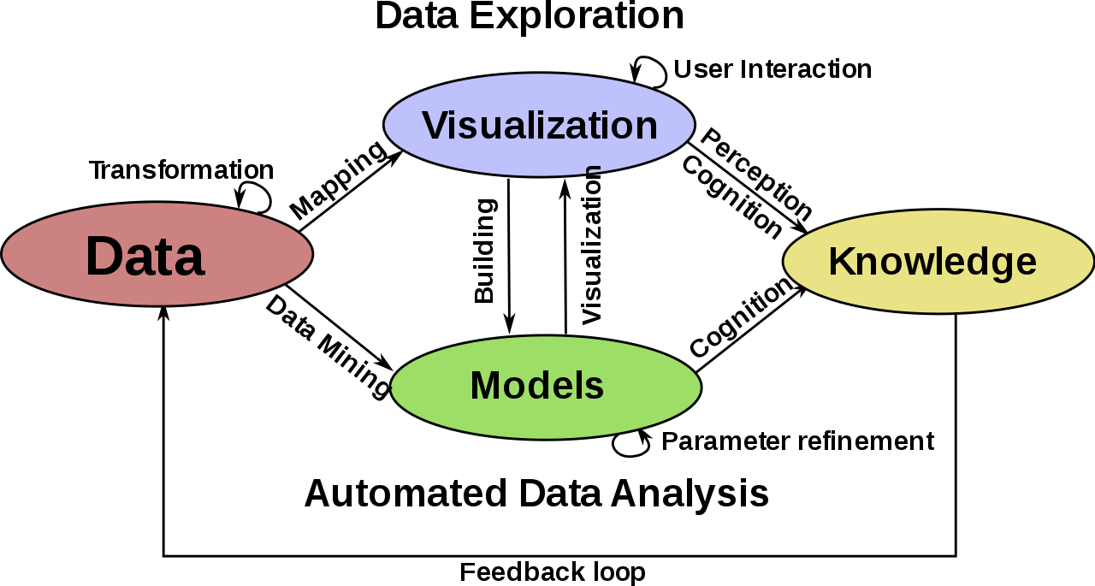
What we will be doing:
Data Exploration of each data set we will be utilizing
Tasks:
Generating recommendations for users of where to eat
Sentiment Analysis
What concerns a customer and what makes a good restaurant
Did a user like or not like a restaurant?
World cloud visualization (Looking at reviews and tips)
Computer Vision task (If we have time) (Image classifier)

Slide 3
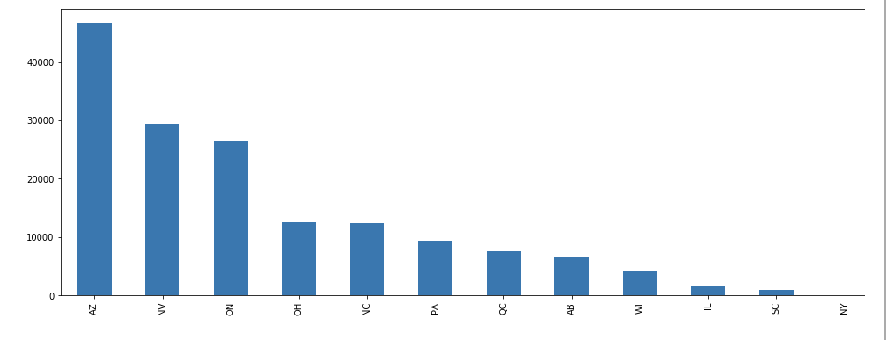
Data Exploration : Let’s Explore Business Data

Slide 4
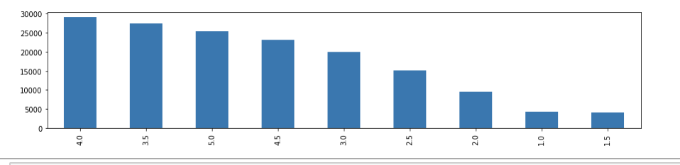
Star Distribution Among Business

Slide 5
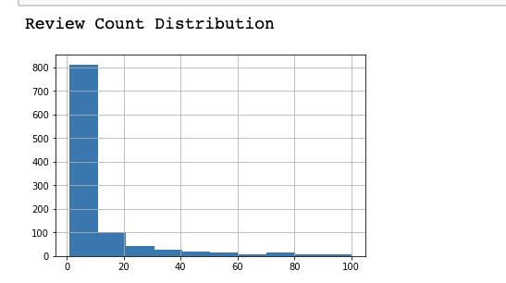
Review Count Distribution
Median Review Count For Businesses= 3
Mean Review Count is Around 135.78

Slide 6
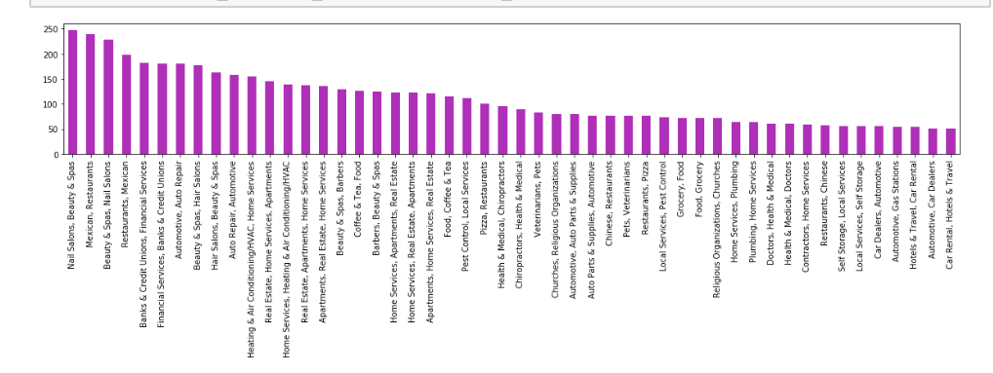
Distribution of Business Categories

Slide 7
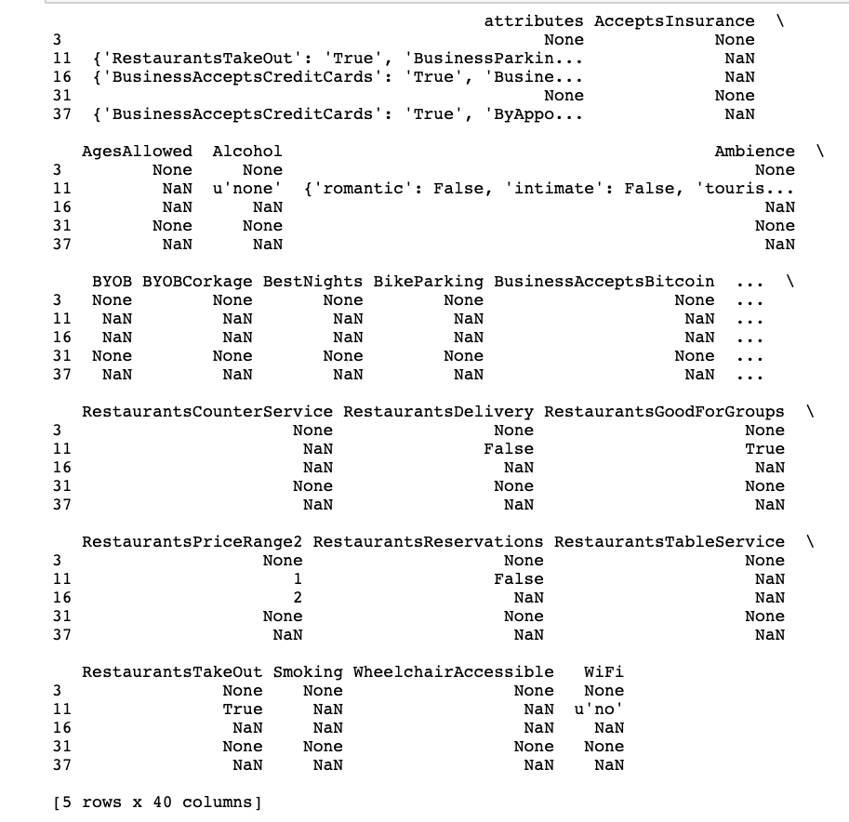
Attributes
3 None
11 {'RestaurantsTakeOut': 'True', 'BusinessParkin...
16 {'BusinessAcceptsCreditCards': 'True', 'Busine...
31 None
37 {'BusinessAcceptsCreditCards': 'True', 'ByAppo...
Exploration of the Attributes:
One hot encoding (break attributes down even further)

Slide 8
Cleaning Tactic for Business Table
For Business Table
We have already narrowed down the businesses to businesses in AZ
We dropped Businesses’ that have a null postal code
We need to determine if there is a way to clean the cities and latitude and longitude to determine if they are valid for this location
We are taking businesses’ with reviews more than 136 reviews. (As the average review count is 135.78)
We are not taking businesses into consideration that have null attributes or categories

Slide 9
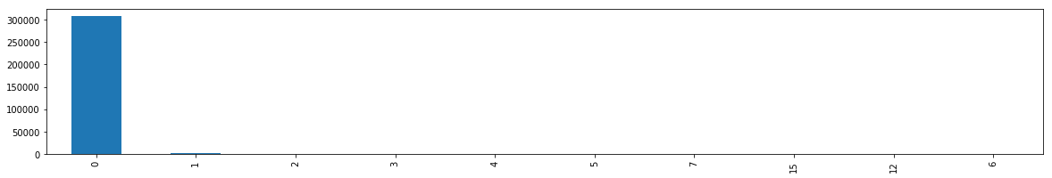
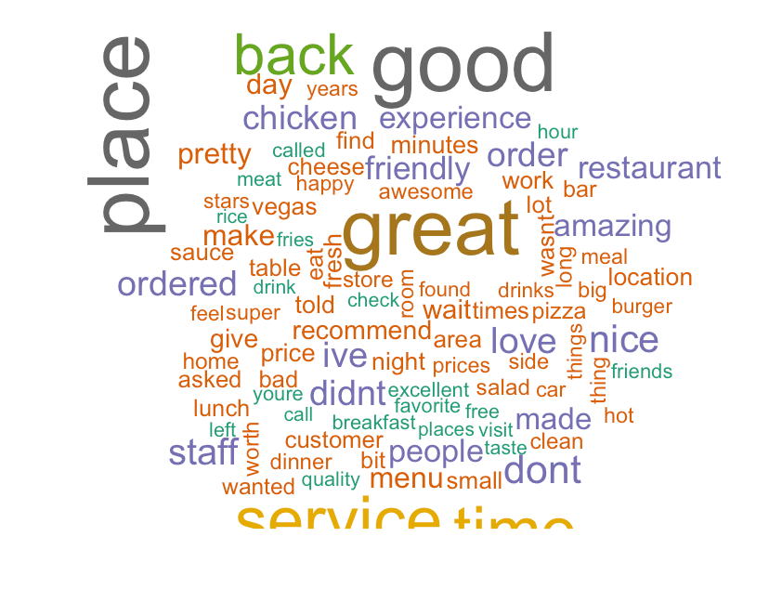
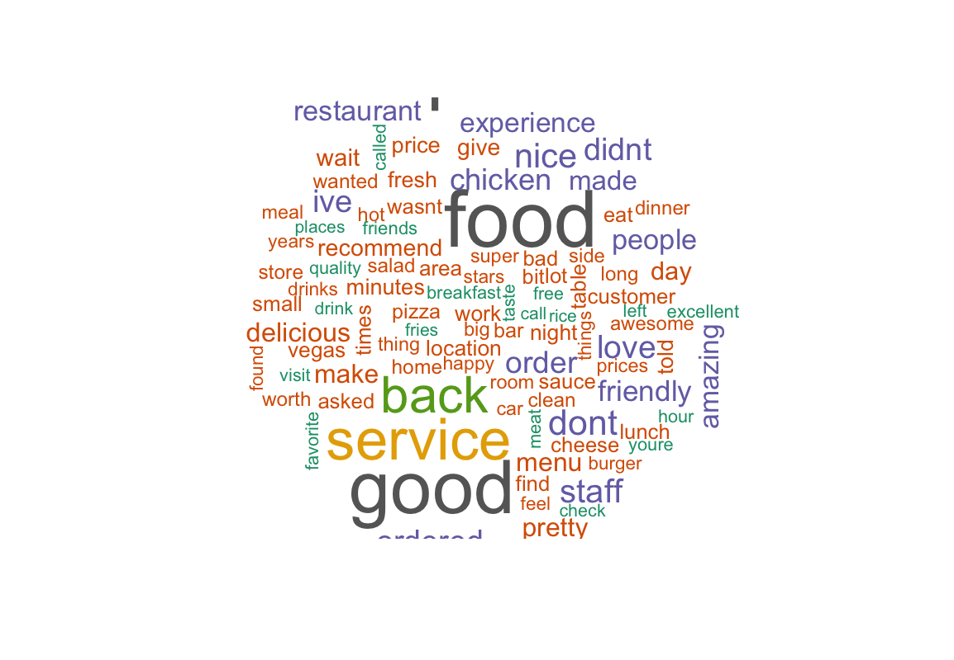
Exploring the Tips Table / Reviews Table
Feature Attributes
No compliment count
Review stars
Text (tips and reviews)

Slide 10
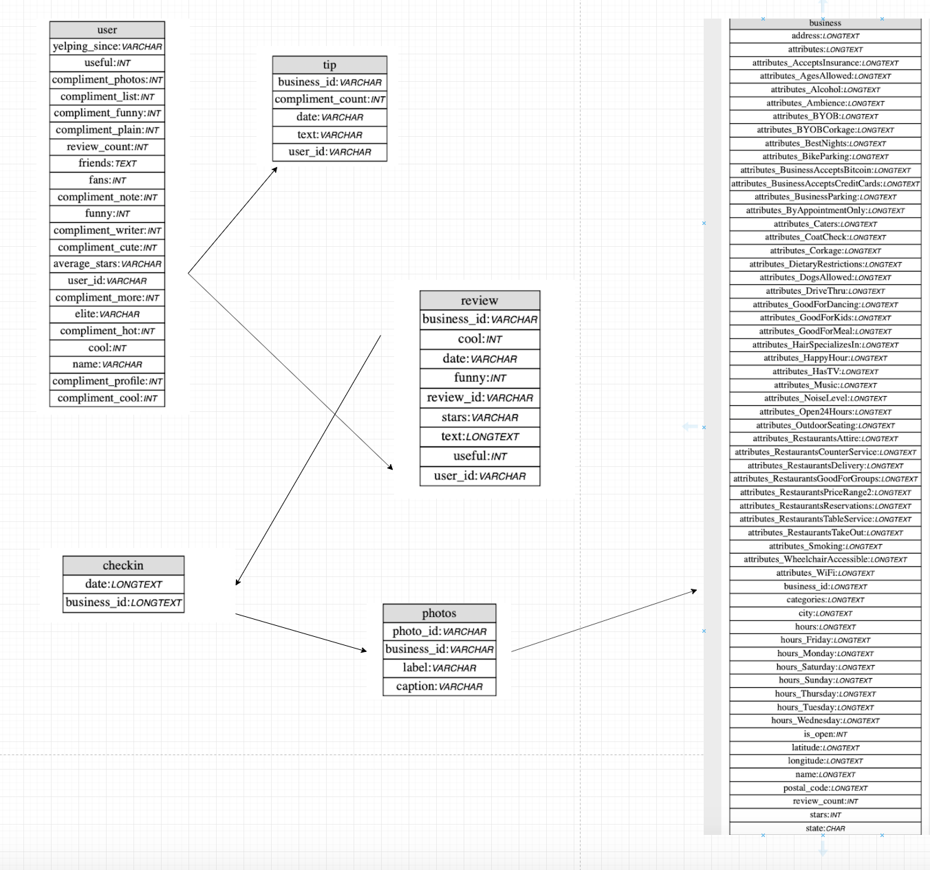
Exploring the User Table
Recalling the entity relational diagram, this table is not needed for our ML tasks. As we can get user identity (user id) via review and tips. (This table does not contain information about places they previously visited)

Slide 11
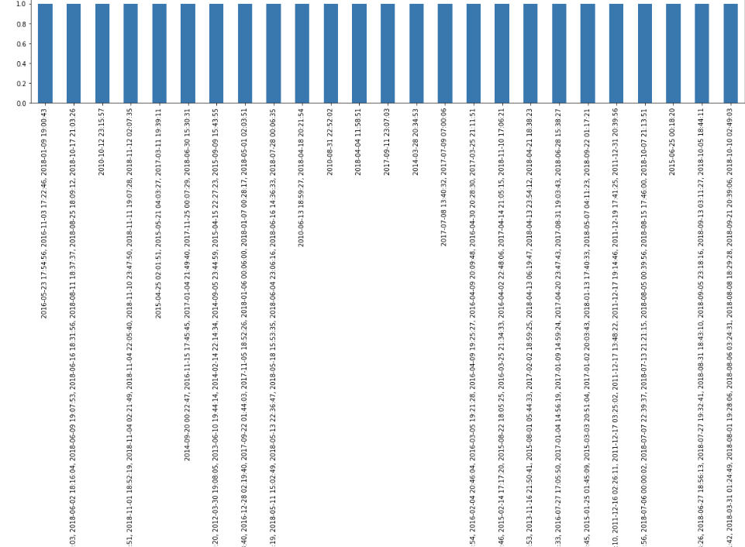
Checkin Table
Not everyone who leaves a review checks in, so this data set will not be used

Slide 12
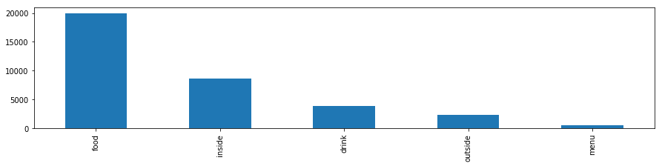
Exploring the Photo Table

Slide 13
So, what is next?
Move on the phase (formatting data to make it more consistent)
Head on to improving data quality (Data cleaning)
Feature engineering
Choose the model(s)
Train the model/evaluate
Parameter tuning
Let’s make predictions

